Slide 1
Simply Visualizing Politics: voxPolitico
Adrian Besimi, Visar Shehu
Contemporary Sciences and Technologies South East European University
www.seeu.edu.mk | www.voxpolitico.org

Slide 2
Outline
Introduction
The Problem vs. The idea and the student involvement
Web crawling for data sources / documents
The problems and the Data structure
Data Mining algorithms
The future
Conclusion

Slide 3
Introduction
A project sponsored by Global Integrity Fund, Washington D.C.
Selected among 370 project ideas
$10.000 in seed money to test our idea
With the main aim to create a future platform (open source)

Slide 4
“We are a society that is data rich, but information poor.”
-Robert H. Waterman
Notes:
Robert H. Waterman, Jr. is a non-fiction author and expert on business management practices

Slide 5
The problem vs. The idea
Unstructured Data: information that does not have a pre-defined data model
The Macedonian Parliament has transcripts of all sessions as e-documents (PDF, DOC)
Huge amount of documents with lots of anomalies
The main idea: Organizing all speeches of the Parliament since 1991 the first session, until nowadays into a new data structure.
Apply Data Mining algorithms to retrieve different conclusions and different results
Visualize them!
Notes:
Unstructured information is typically text-heavy, but may contain data such as dates, numbers, and facts as well.

Slide 6
Student Involvement
How to involve undergraduate students in “real world” projects?
Not all students are happy to work on real projects.
Challenging students sometimes works!

Slide 8
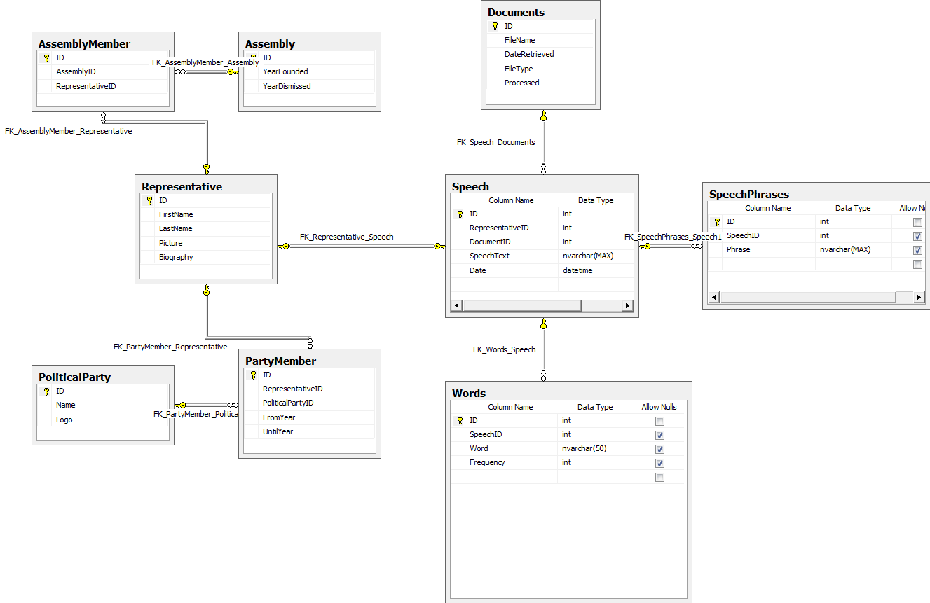
Representatives: Crawling
Party
Representative
Assembly

Slide 9
Representatives: Mapping
Party
Representative
Assembly

Slide 10
The sources
Started with analyzing the structure of a single document.
Different document types (PDF, new PDF, Word)
Since 2006 the documents are in word format.
The structure was not well defined.
Manually analyzing the documents and identify the elements that would make the process of organization easier

Slide 11
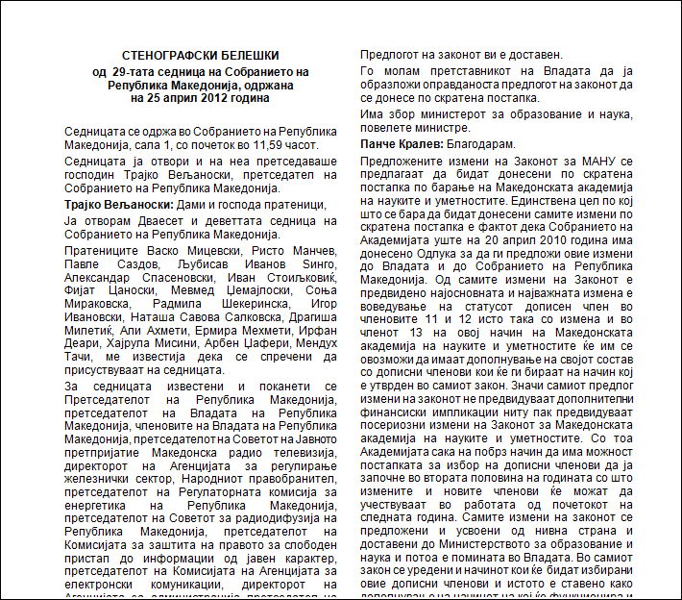
Sample document
FORMATS:
PDF
WORD 95
WORD 97
WORD 2003
WORD 2007

Slide 12
Sample document: Pre-processing
Document
Date
Representative
Speech

Slide 13
Sample document: Mapping
Document
Date
Representative
Speech

Slide 14
The Database

Slide 15
The problems
Different typo’s, problems with delimiter:
Some documents contain “FirstName LastName” format, some “LastName FirstName”
Some documents contain “:” to determine new speech, some do not
Sometimes there are no spaces between phrases
Sometimes a phrase ends with brackets “)”
Governmental representatives do have speeches which we record, but ignore in the display of the results

Slide 16
The structured data
ASSEMBLY
REPRESENTATIVE
SPEECH
SPEECH PHRASES
WORDS
FREQUENT WORDS
ASSEMBLY
DOCUMENTS
SPEECHES
SPEECH PHRASES
WORDS

Slide 17
Data Mining
Two main algorithms:
Cosine Similarity: to calculating the similarity between two vectors -> generated a similarity matrix for each two representatives based on their speeches
Apriori algorithm for generating frequent item sets of words for particular representative

Slide 18
Data Mining: Cosine Similarity
A large similarity matrix, around 750.000 records
95% is pre-calculated, before the launch
No need to modify, except when new documents are submitted
Example: On the fly, find the MP similarity with other MPs, current or from the past

Slide 19
Data Mining: Frequent Item sets generation using Apriori Algorithm
Find the most common words (eliminating the outliers)
Create combinations of the words that meet a certain minimum support
Finally, create the vector of frequent words used by MPs.
Example: Find the most common phrase used by this or another MP

Slide 20
Visualization
Visualizing the results was the overall goal of the project!
Using WebGL, D3.JS and Google Charts
Visualize general statistics: Number of speeches, most used words, comparing two MPs, displaying the similarity between representatives, find the most common phrases used by representatives, time series of data (words used), etc.

Slide 21
Next steps
Include translation on-the-fly using Google or BING
Include voting by MPs for different Laws
Try to link sessions of the parliament with particular events?

Slide 22
Conclusion
Challenging students may result in good project
Even documents without a predefined structure can be used for data mining if one can know how to “read” them
Structured data gathered from text can be used for various statistical calculations
If these data are put on the web and visualized appropriately, they can be easily used by any one without the need to read all the hundred of thousand of speeches.

Slide 23
Thank You!
Any questions?
Contacts:
a.besimi@seeu.edu.mk
www.seeu.edu.mk | www.voxpolitico.org

